Slide 1
Capstone Project - The Battle of the Neighbourhoods
Applied Data Science Capstone by IBM/ Coursera
by Sowmiya Ranganathan

Slide 2
Best Restaurants Surfing through Zomato - New Delhi
Table of contents
Introduction: Business Problem
Data
Methodology
Analysis
Results and Discussion
Conclusion

Slide 3
Introduction: Business Problem
This project aims to select the nearest restaurant listed out in Zomato based on the specified location . Specifically this report will be targeted to the customers who wants to have a dine-in in the restaurant of their likings.
New Delhi being the capital of India is filled with people with various likings, taste and preferences. When there is a weekend the tendency of the people is to spend a quality time with family and explore different places surrounding them. With the advancement in technology various apps provide the details of the places, restaurants and venues. Zomato being one of the popular app in this category provides details of the restaurants, ratings, the type of cuisine, the feedbacks given by the peer customers helps the people to identify more conveniently with just few clicks.

Slide 4
We will focus on the top restaurants in neighborhoods and the 5 most common venues in each neighborhood so that the best place to spend weekend suited to an individual's needs can be selected.
The following questions will be focused on and answered:
Which type of cuisine is commonly found in the restaurants?
Whether the cost specified under each restaurant is affecting its rating?
Listing out the restaurants that provides Pre-Book option
What are the restaurants surrounding the specified location?
Final one to list out the other options/venues surrounding the location to spend the valuable time.

Slide 5
Data
Based on definition of our problem, factors that will influence our decision are:
number of restaurants in the neighborhood (any type of restaurant)
number of and distance of venues in the neighborhood, if any
We decided to use regularly spaced grid of locations, centered around city center, to define our neighborhoods.
Following data sources will be needed to extract/generate the required information:
number of restaurants and their type and location in every neighborhood will be obtained using Foursquare API
coordinate of the venues for the selected restaurant will be obtained using Foursquare API
The dataset has been gathered from Kaggle
Reference: https://www.kaggle.com/sominwadhwa/where-what-to-eat-in-delhi-india-mapbox-w-plotly
This is going to be interesting...!

Slide 6
Methodology
In this project we will direct our efforts on detecting areas of New Delhi that have restaurants, particularly those with other venues.
In first step we will concentrate on the cuisines of the restaurant. It will show a analysis of how many restaurants offers particular type of cuisine which helps to find out which cuisine is liked by the people in New Delhi.
Second step in our analysis will be to find out whether the cost is affecting the rating. Since if we choose a restaurant the first thing to be noted is to find out the ratings of the restaurant in order to find the top restaurants. In this analysis we will find out whether the cost of the food is affecting the rating.
Third step is mainly for the dine in where people check whether pre-book of table is available of out. This is most essential in the case of family day out.

Slide 7
In Fourth step we will find the nearby restaurant for the location specified. Here we will use Foursquare API to find out only the restaurants neatby the location and also other nearby venues to plan the weekend accordingly.
In fifth and final step we will focus on most promising areas and within those create clusters of locations that are the neighborhood of the New Delhi and they are clustered based on the categories of the venues in those locality. We will present map of all such locations but also create clusters (using k-means clustering) of those locations to identify general zones / neighborhoods / addresses which should be a starting point for final 'street level' exploration.

Slide 8
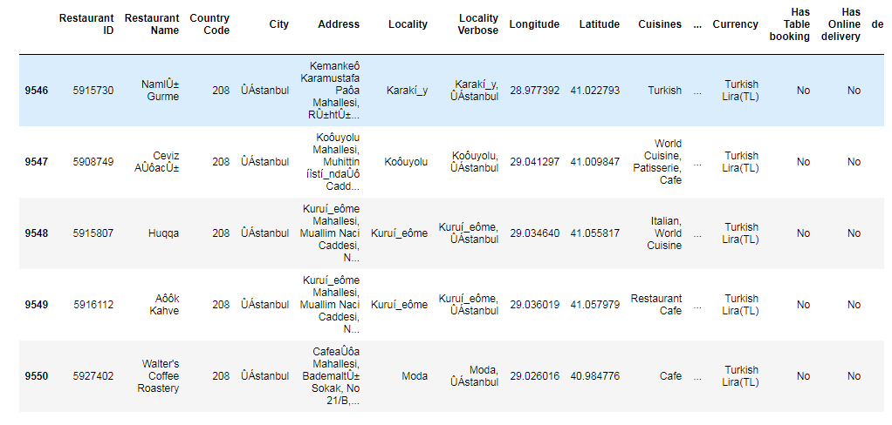
Sneak Peak into the Dataset

Slide 9
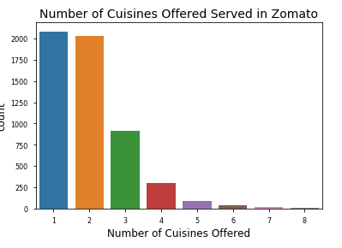
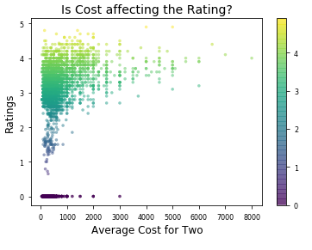
Analysis
1. Number of Cuisines offered by the Restaurant | 2. Are ratings affected by how cheap/expensive a restaurant is?

Slide 10
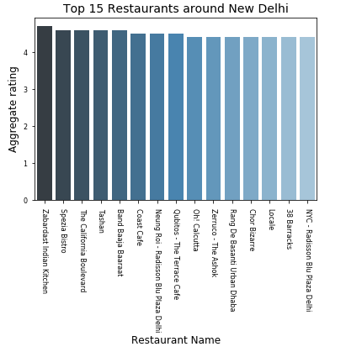
Analysis
3. Pre-booking a Lunch/Dinner on Perfect Weekend?

Slide 11

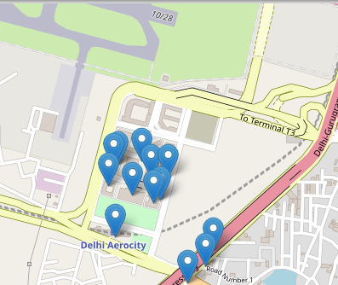
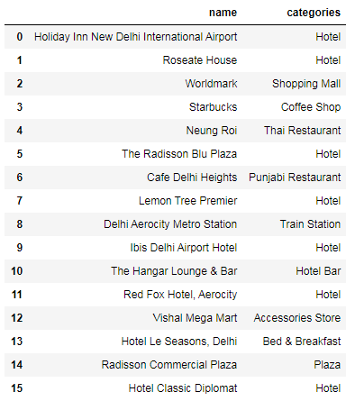
4. Looking for a Restaurant near you?
Other Venues:

Slide 12
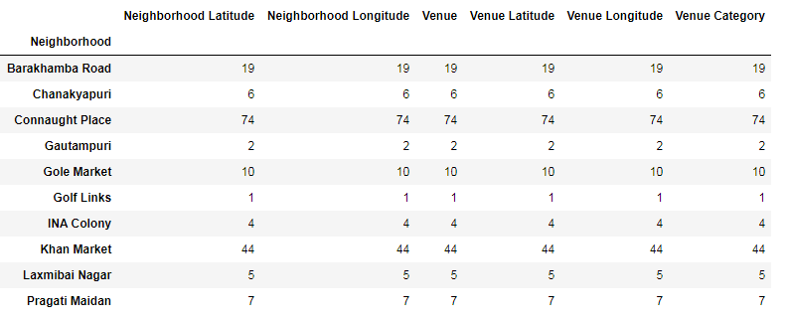
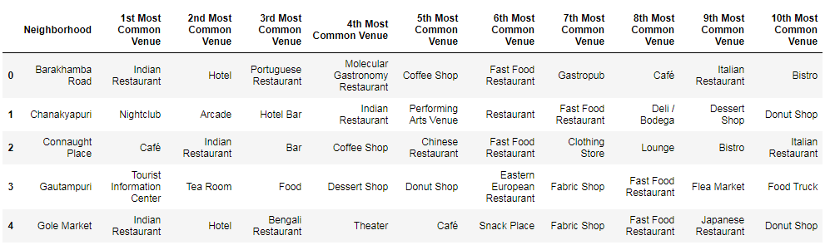
5. Explore Neighborhoods in New Delhi

Slide 13
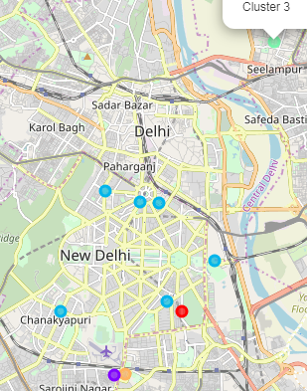
6. Clustering the Neighborhood
Cluster 0
Cluster 1
Cluster 2-Neighborhood with more number of restaurants
Cluster 3
Cluster 4

Slide 14
Results and Discussion
Our analysis shows that although there is a great number of restaurants in New Delhi , people prefer those restaurants with highest rating and those restaurants were other venues can be easily reached through to plan out for a perfect weekend. This project helps us to find those Top rated restaurants in the specified Locality along with other places that can be visited.
We have even specified the distance of each venue from the locality in order to choose from the best and have shorter distance than to travel further.
With the help of Clustering we were able to identify that most of the neighbourhoods of New Delhi has been mainly clustered based out of the restaurants in their locality this shows that the with the increasing population the tendency of the people to spend their weekend in restaurants has been increasing proportionally.
I also performed data analysis through this information by adding the coordinates of localities and the data provided by Zomato such as ratings, cost for two, type of cuisine offered, upvotes etc., . In future studies, these can be used for further analysis of how a restaurant is progressing and which will be the best location to open a new restaurant based on the other restaurant's parameters.

Slide 15
Conclusion
As a result, people are turning to big cities to start a business or work. For this reason, the migration population is also increasing tremendously which leads the people to hang around during the weekends. This led to the increase of restaurants and the cuisines offered by them. With this analysis people can find out the restaurants nearby and other venues to plan out accordingly.
Not only for people but also business man who wants to start over new restaurants can use the similar data analysis for finding out the perfect location to start out.

